Slide 1

GitHub Copilot
Inline and
Next edit Suggestions

Slide 2
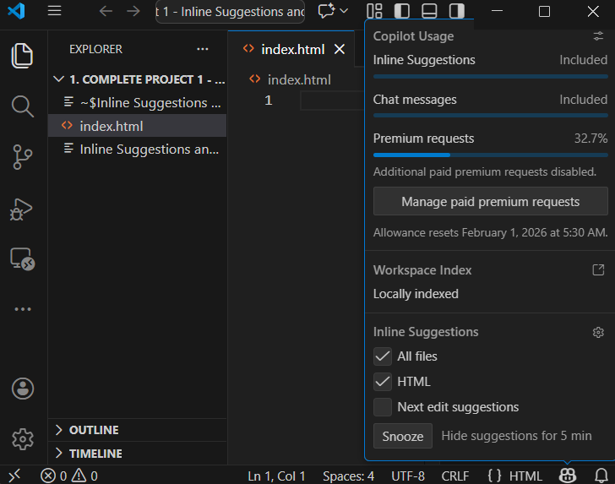
Add artifacts
Add a blank directory and name it appropriately
Start VS Code and login using GitHub Account
Open the folder in VS Code
Add a new file index.html
In Status bar , click on copilot icon
From copilot usage pop up unselect
  Unselect Next Edit Suggestions

Slide 3
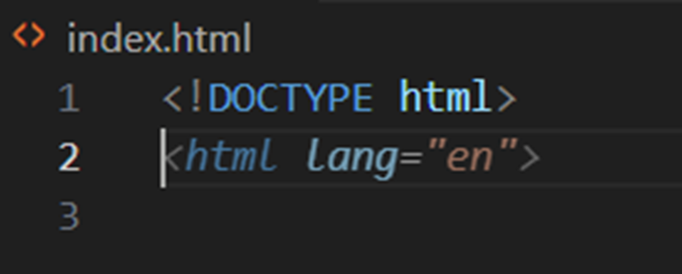

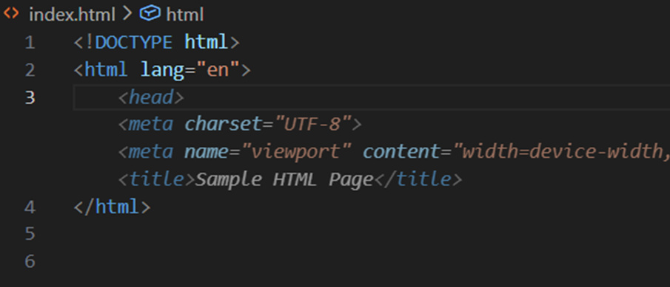
Ghost suggestion
In Index.html start typing the basic code
  <!DOCTYPE html>
Once press enter after the first line, a new line appears in italic mode , which is called Ghost Suggestions
Ghost suggestions are nothing but inline Suggestions
Once you accept the current suggestions, further suggestions appear which are called FIM viz., Fill-in-middle
FIM is the LLM behaviour, which takes the context from the cursor position and fills the code automatically based on its training

Slide 4
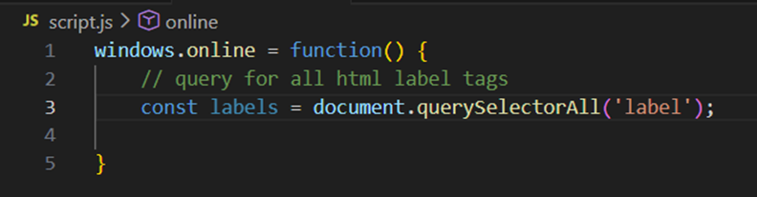
suggestions with comments
But in the previous slide what ever we were building without context
To understand how to start with a context lets begin with a JavaScript file
Type windows.online = function() {} And then add a comment as a context
// query for all html label tags
Then copilot will fill the rest of code as inline suggestion
with FIM

Slide 5
Next edit suggestions
The Next Edit Suggestions (NES) feature of GitHub Copilot uses your recent edits to anticipate the next edit
Enable next edit suggestions
Various use cases
  Catch and correct mistakes
  Match a change in intent
  Update code syntax
  Refactor

Slide 6

Catch and correct mistakes

Slide 7
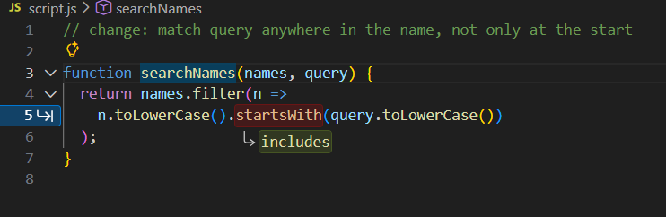
Match and change in intent

Slide 8
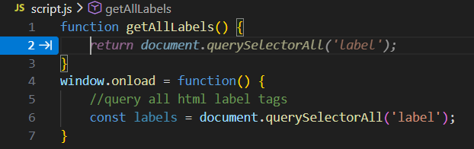
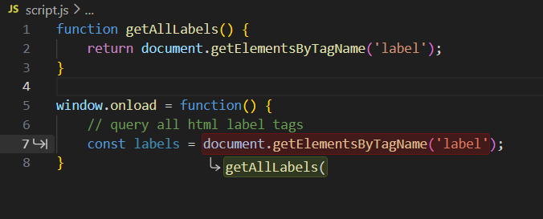
Update code syntax

Slide 9
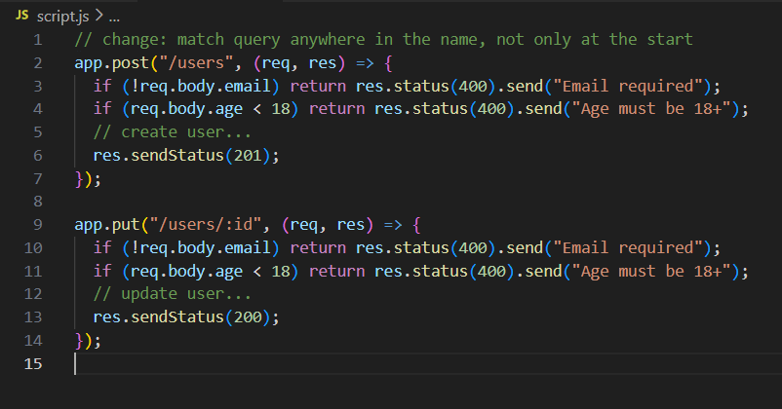
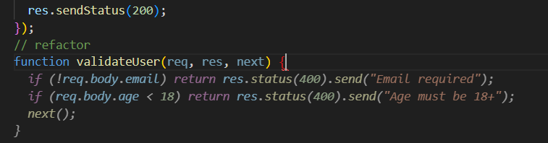
refactor

Slide 10


Code snippets for practice
function searchNames(names, query) {
return names.filter(n =>
n.toLowerCase().startsWith(query.toLowerCase())
);
}
const activeUsers = users.filter(u => {
u.isActive;
});
// Change: match query anywhere in the name, not only at the start

